Slide 1

Sentimental
Analysis Plug-In
Technical Considerations

Slide 2
Technical Process
Platform
Where?
Gathering Data
How?
Tech Stack
What?
Content Display
What?

Slide 3

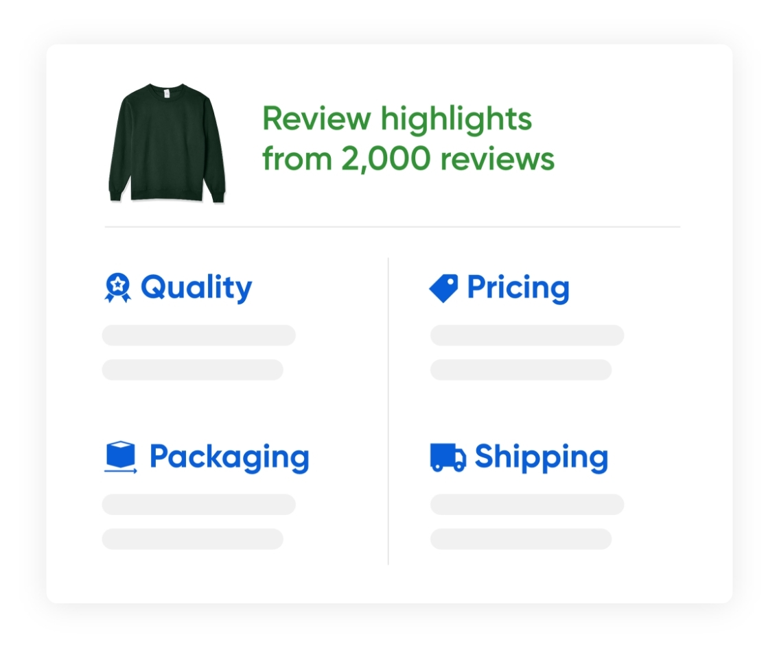
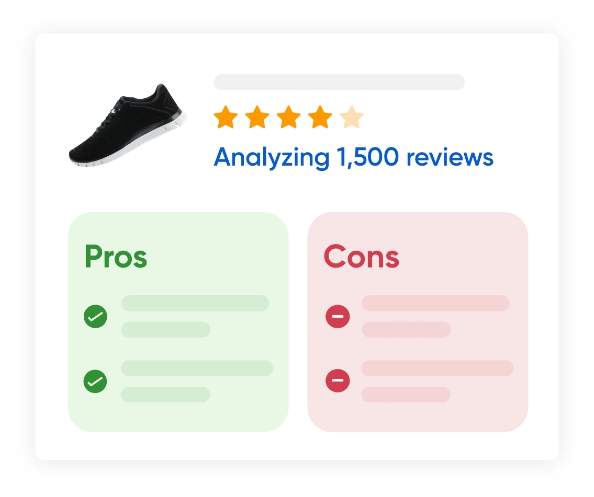
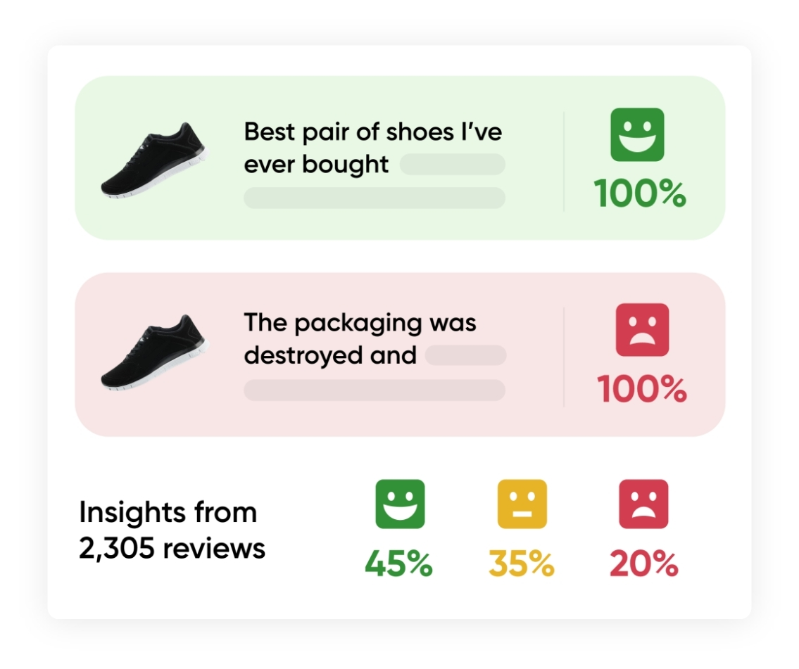

Platform
Browser extension/plugin
Chrome
Firefox
Website
Give complete analysis on pasting the URL
Notes:
Two types of platforms are used:
Browser Extension
Website
Browser takes the url from the respective website and sends to the backend
The customer has to paste the url for which they want to analyse

Slide 4

Gathering data
1. WEB SCRAPING
Pros
Flexibility
Automation
Cons
Technical Complexity(Pagination, Lazy loading)
Legal problems (terms & conditions, privacy concerns)
Block Scraping for security reasons
Notes:
Legal Problems:
Terms of Service and Website Policies
Copyright Infringement (Unauthorized use)
Unauthorized Access
Privacy and Data Protection

Slide 5

Gathering data
2. API
Pros
Data reliability
Efficiency
Scalability
Security
Compliance
Cons
Cost
Varies for different Product/ services
Notes:
API:
Initially one website (trip advisor)
The backend process remains the same, only the api access differs that can be handled in separate classes

Slide 6









Tech Stack
Program Language
Browser Extension
NLP Transformer Models
Hosting
VADER
Notes:
Front end:
HTML
CSS
JS
React (optional)
Backend:
Python
Flask
NLP models
Hosting:
AWS - Lambda (serverless platform)

Slide 7
Technical Flowchart
Identity products/services
Get data through API
Sentiment analysis
Processed data
Browser Website
Programming
Language
Trained NLP models
Getting URL
Getting data
Sending Results
Browser Plugin
Display output
3rd party APIS
Browser Plugin

Slide 8
System design architecture : Example: Tripadvisor.com
Trip Advisor APIs
Browser
Server- AWS
Hotel info(string)
Reviews
(json)
Sending
Reviews
Trip advisor.com
NLP models
Python + Flask
Website + hotel info
Getting URL
Bert
Overall score(number)
Extension
(HTML + Script)
Aspect Analysis (String)
Spacy
Rule based Analysis (string)
Vader
Notes:
The NLP models have limitations as well such as 512 input tokens for Bert which can be handled by parallel process. The above models seems to be well situated for our use-case

Slide 9


Content Display - What users see
Overall Score/ Grade
Insights
(positive & negative)
Most Positive/ Negative
Aspect Feedback
Notes:
The scoring data is displayed first to give an overall impression to the customers
The scoring data can be Rule based (domain specific, +ve and -ve numbers)
Most discussed topic in positive and negative cases

Slide 10
Demo

Slide 11
Optimisation
Instead of using one model, various pre trained models are used for respective purposes
Each model are handled asynchronously to avoid waiting time
Parallel processing of GPUs
If there are more than 10000+ reviews, we can analyse the latest reviews eg: taking reviews from last 1 year
Notes:
The model processing speed is based on the hardware, model, complexity of input etc.
We can fine tune the model. Approx for 1000 records it will take upto seconds to minutes but have to rest and see

Slide 12
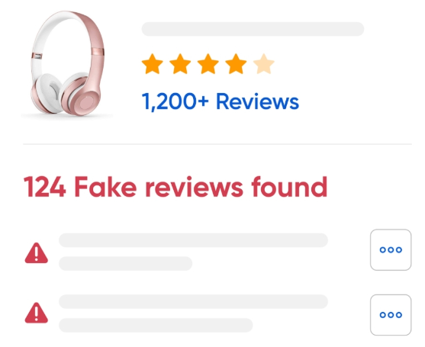
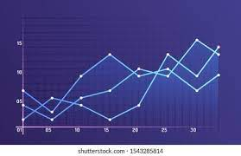

Enhancing Functionality
Fake Review Analysis
Graphs on previous prices
Multilingual Support (German, French, etc)

Slide 13



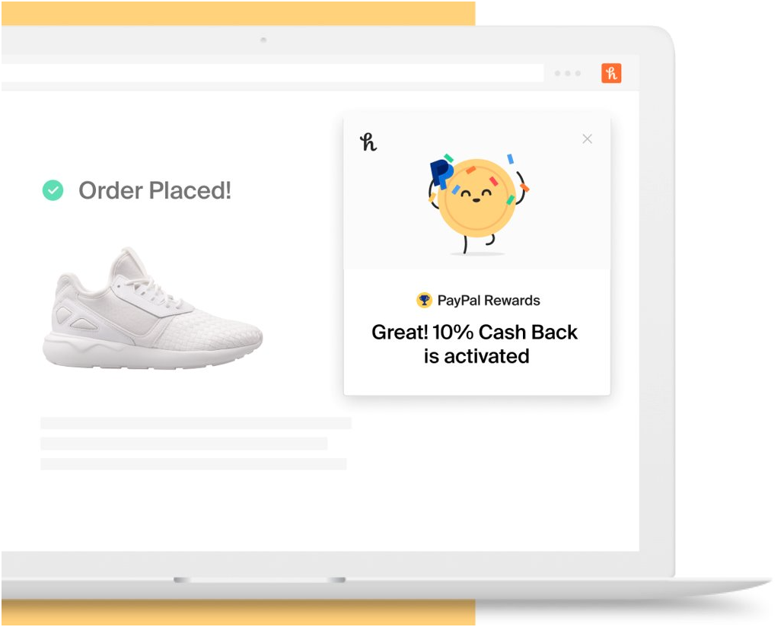
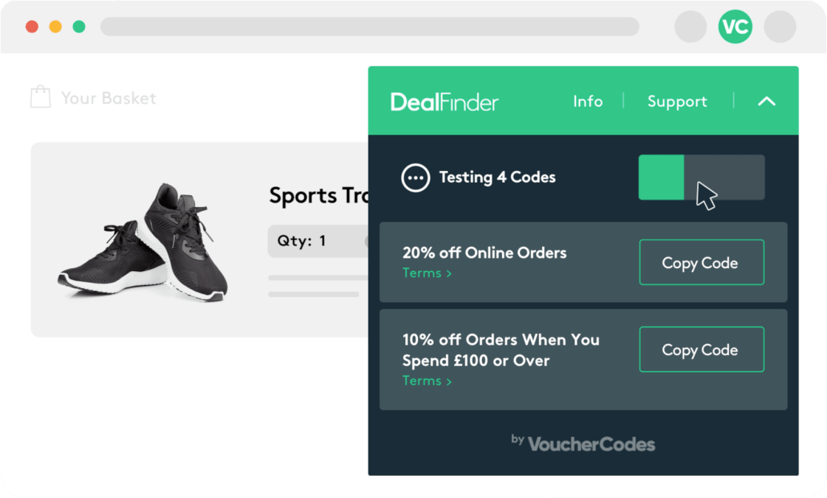
Competitor analysis - Research
FakeSpot
ReviewMeta
Similar Options to consider
Honey
Deal finder

Slide 14

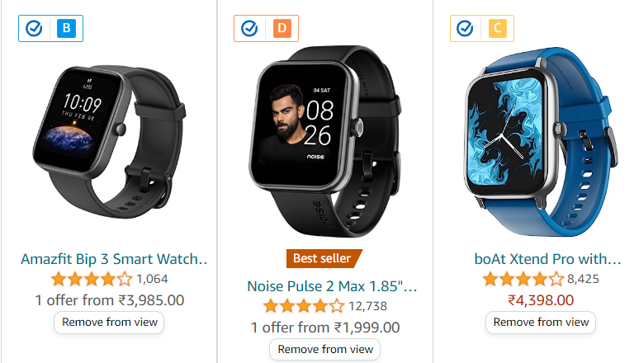
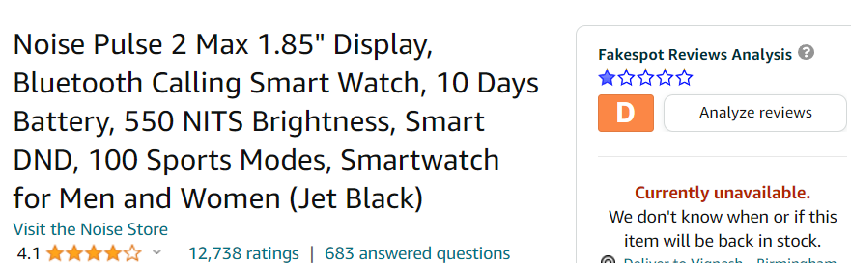
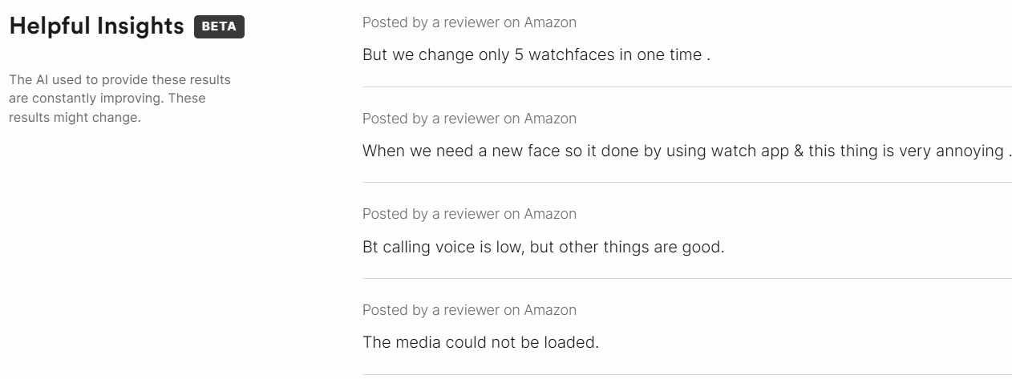
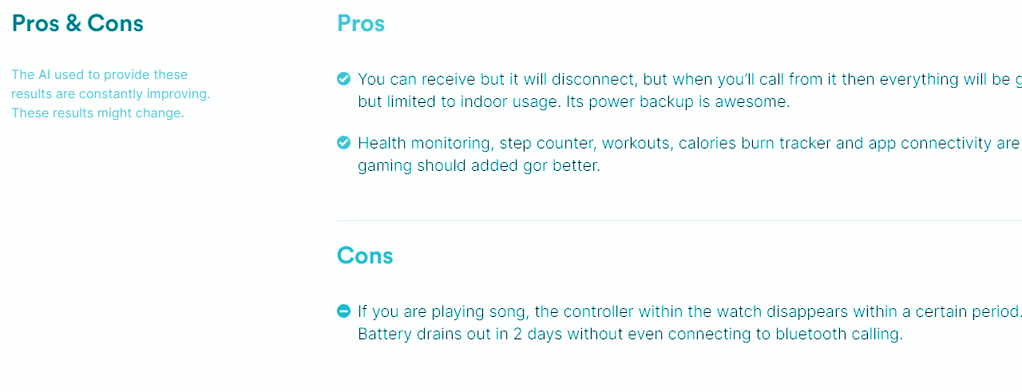
COMPETITOR ANALYSIS
Fake Spot
Focuses top ecommerce platforms
Notes:
Ecommerce - Amazon, shopify, Walmart
Embedded features
Gives grading on products and redirects to website for full analysis

Slide 15
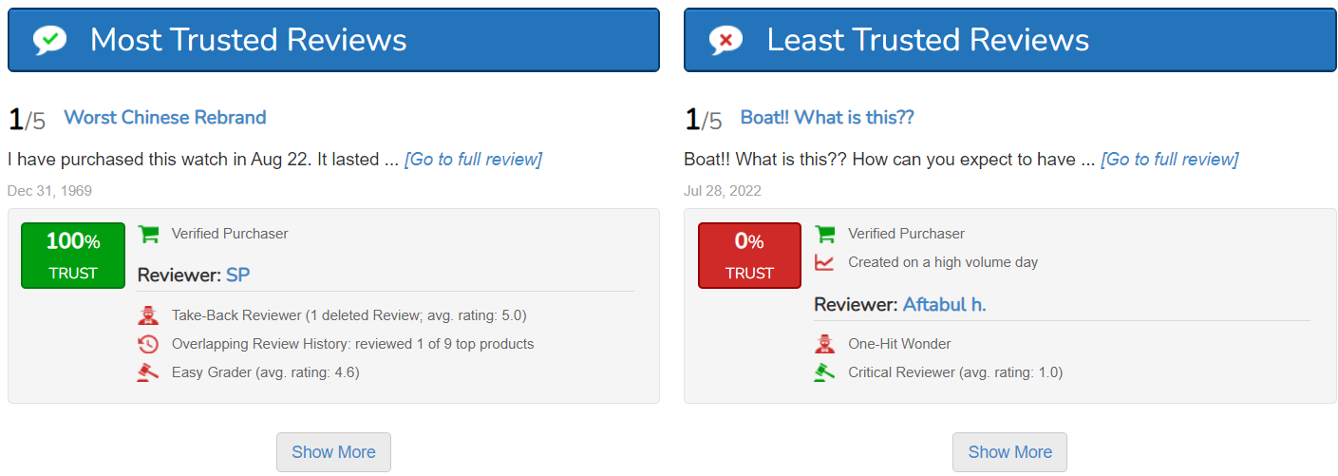
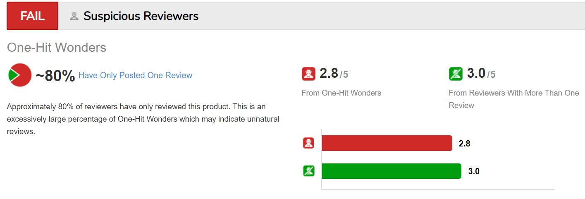
COMPETITOR ANALYSYS
ReviewMeta
Amazon products in different countries

